Slide 1
Opening a restaurant in Edmonton

Slide 2
Data acquisition and cleaning
Geographical coordinates and relative information of the neighborhoods are scraped from the City of Edmonton open data bank
Information about the distribution of population by their age, sex, income, education, religion, race are scraped from City of Edmonton and Statistic Canada open data bank
location and other information about various venues in Edmonton are scraped from Foursquare, Yelp and Zomato explore API
Only focused on neighbourhood within developing, established, and mature areas (includes central core areas and downtown area)
Consist neighborhoods with different names in time period

Slide 3
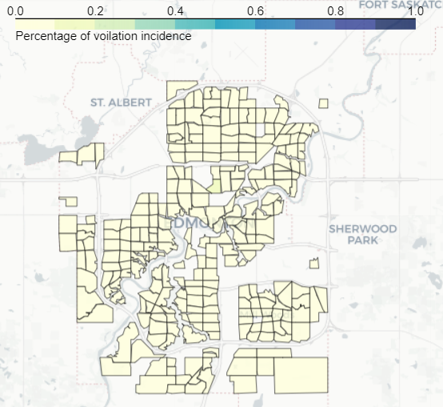
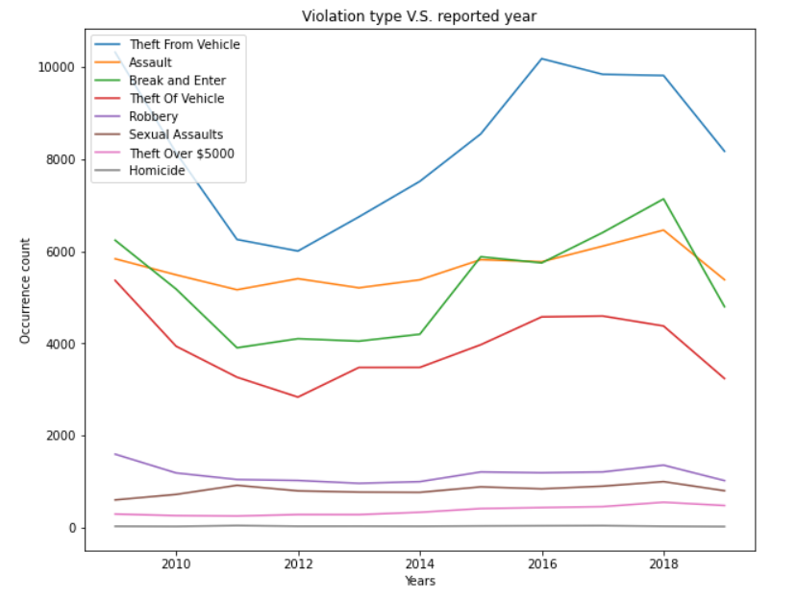
Is it a safe place to startup a business?
Yes! Low violation incident rate and decreasing violation incident number.

Slide 4
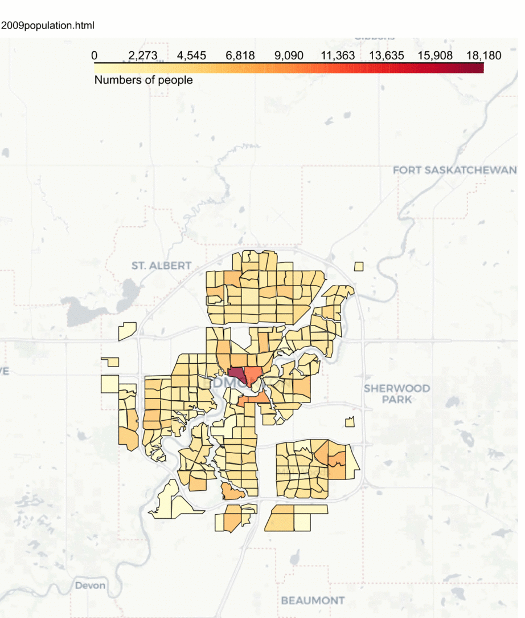
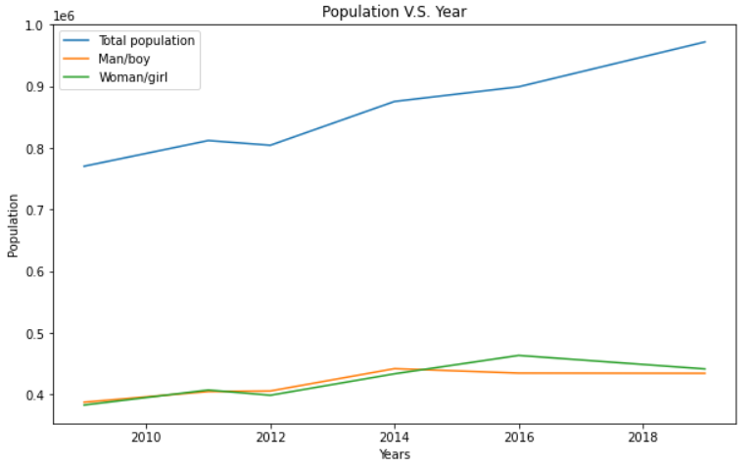
Is it a proper place to startup a business?
Yes! There are increasing numbers of people moving into this city.

Slide 5
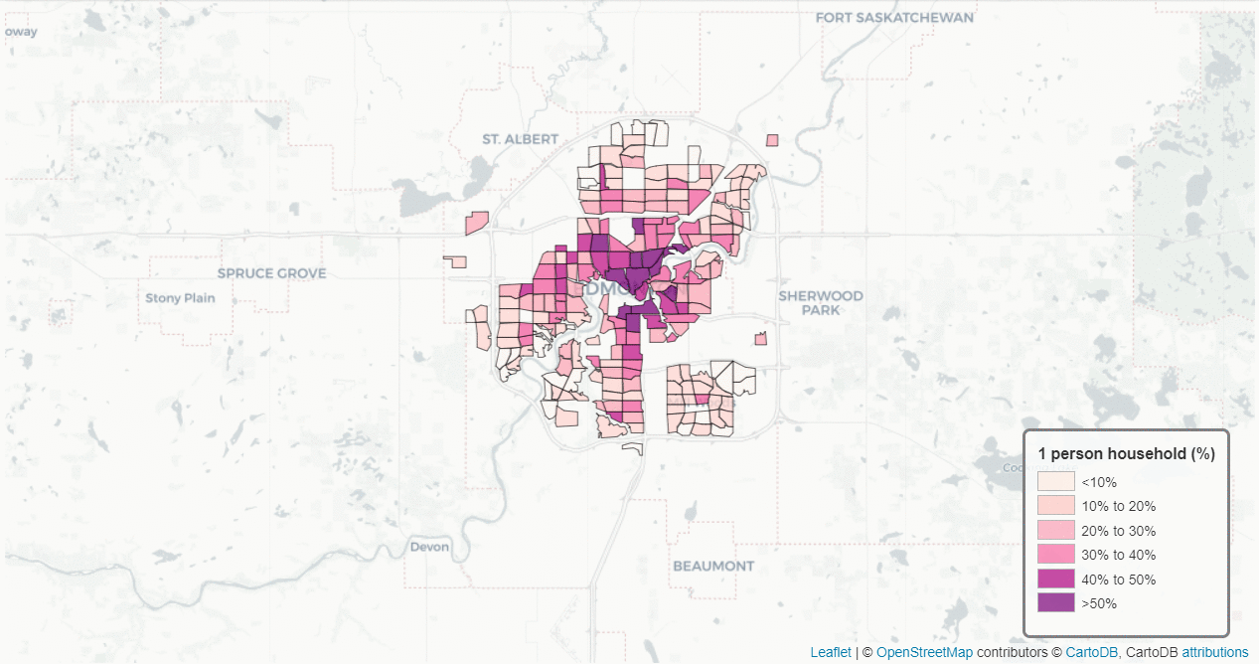
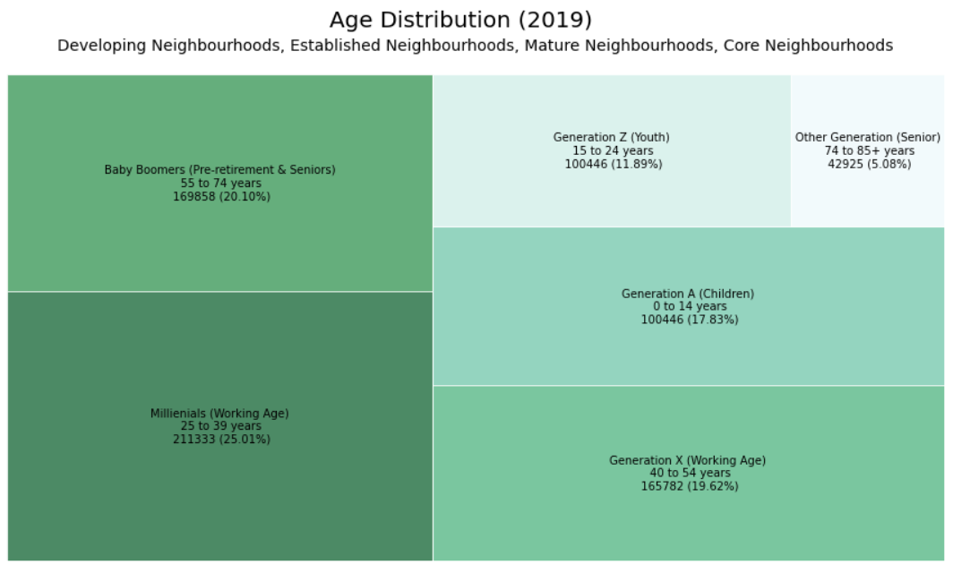
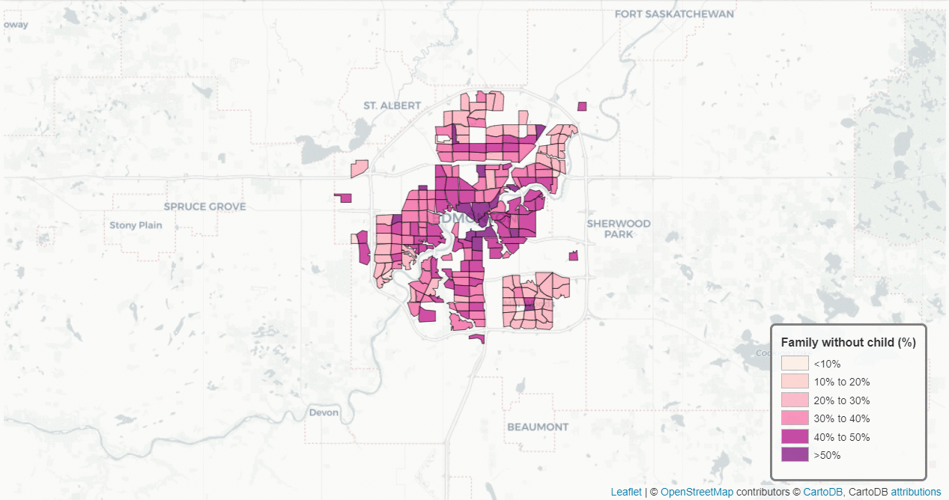
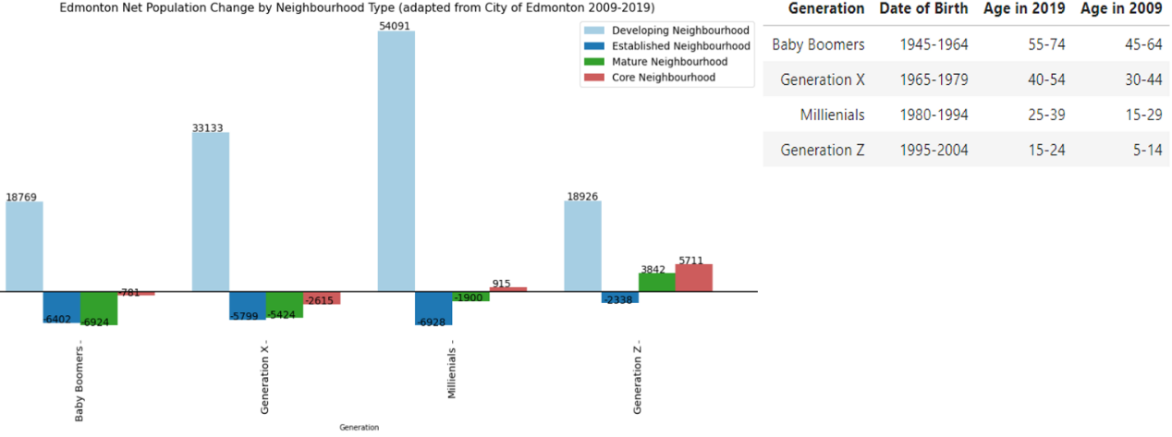
Who will the target customers be?
1. Single or no child Millennials
2. Middle income class, with university+ education

Slide 6
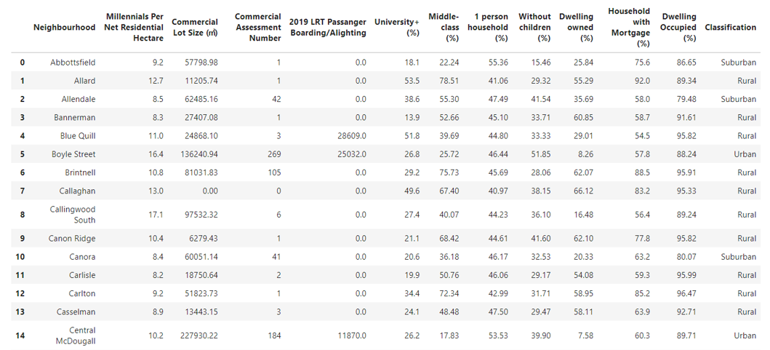
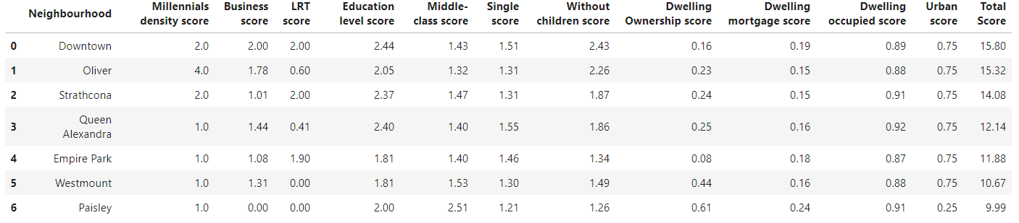
Where can you serve your guests?
≥8
≥45%
≥40%
≥40%
≥40%

Slide 7
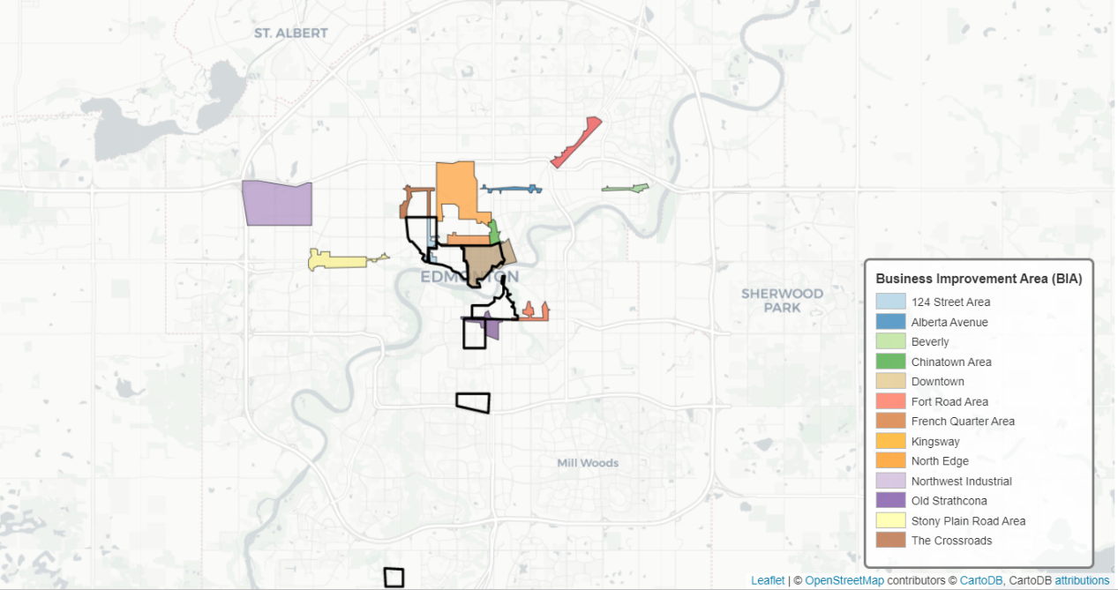
Where can you serve your guests? (Neighborhood)

Slide 8
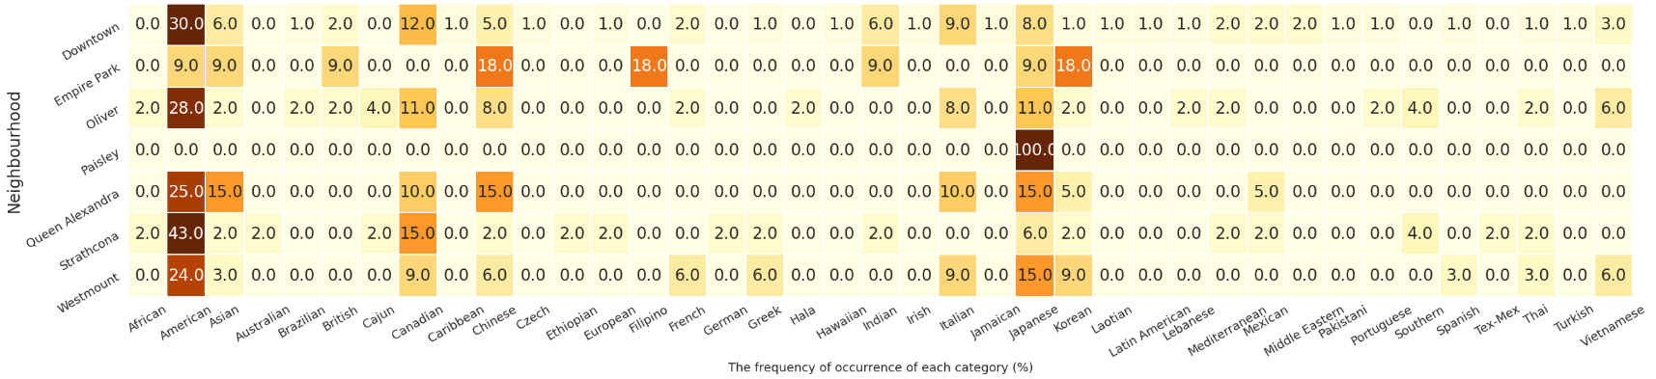
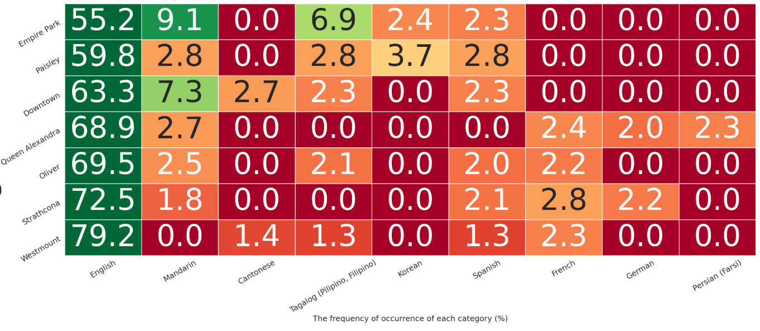
What will you offer them?
Ethnic cuisines
The least competition for the new upcoming restaurant in corresponding neighborhood

Slide 9
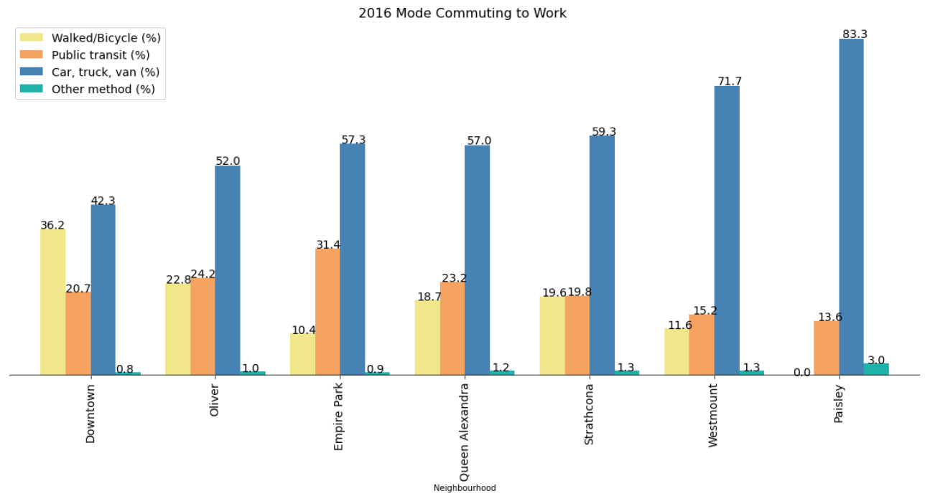
When will they come to your restaurant?
Paisley: weeknights, weekends, and holidays. It will be better for the restaurant provide both eat in and takeaway services.
Downtown, Oliver, Strathcona, Queen Alexandra, Empire park, and Westmount: lunch hours, weeknights, weekends, and holidays. It would be a good idea to offer business lunches and setup afternoon happy hours.

Slide 10
Conclusion and future directions
Construct visualizations to select target customer segment
Built useful models to evaluate neighborhoods of Edmonton
Explore the venues in neighborhoods of Edmonton

